Slide 1


Online Payment Fraud Detection
Presented by
Yash Gupta
Nitesh Saxena

Slide 2
Introduction
Online payments have become increasingly popular for both small and large transactions due to their convenience—whether it's using a card, net banking, or digital wallets.
However, with the rise in online payment usage, fraud incidences, such as unauthorized transactions, have also surged.
Malicious apps, phishing attacks, and viruses, often entering through unsecured files or APKs, are common sources of these fraudulent activities.
Our objective is to utilize machine learning to detect online payment fraud in real-time and promptly notify users.
Machine learning models analyze patterns and anomalies in transaction data across various payment methods to identify and prevent potential fraud.

Slide 3
Problems
Growing Fraud Incidents : The rapid increase in online adoption has led to a parallel rise in fraudulent activities, targeting both small and large transactions.
Unauthorized Transactions : Users frequently report cases of unauthorized transactions, often resulting in significant financial losses.
Malicious Software : Fraudsters exploit malicious apps, viruses, and unauthorized APKs to gain access to users' credentials and initiate fraudulent transfers.
Lack of Early Detection : Existing systems often fail to detect fraud in real-time, allowing fraudulent transactions to go unnoticed until it's too late.
User Awareness: Many users are unaware of potential fraud risks and lack knowledge of secure UPI practices, making them vulnerable to scams.

Slide 4
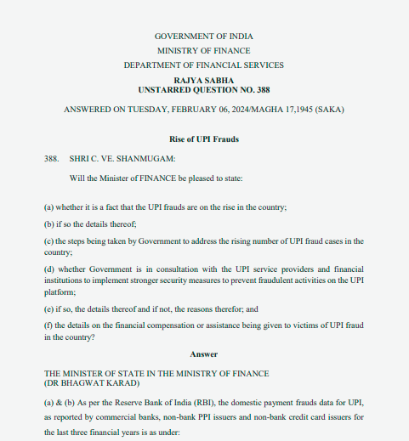
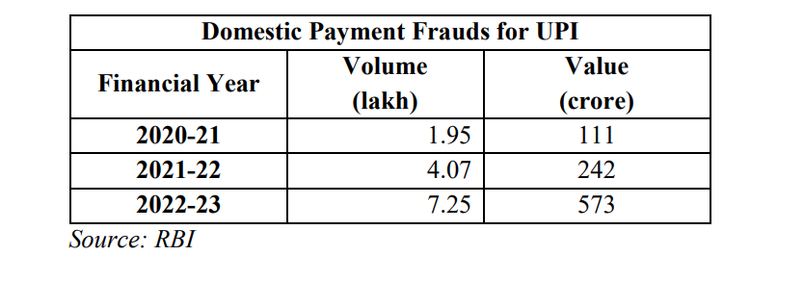
Fraud Report’s
Reference : https://sansad.in/getFile/annex/263/AU388.pdf?source=pqars

Slide 5




Objectives
Our aim is to detect and prevent both small and large
frauds occurring daily, ensuring secure transactions and safeguarding users from financial losses.
Comprehensive Fraud Detection
Real-Time Protection
Enhanced Transaction Security

Slide 6
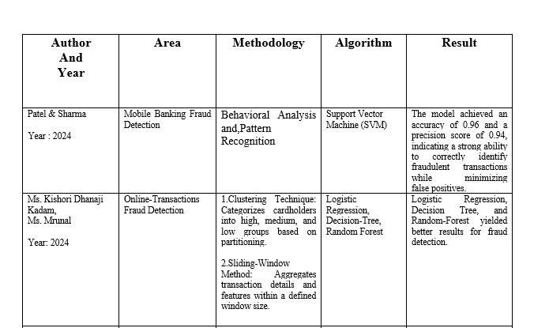
LITERATURE SURVEY TABLE

Slide 7
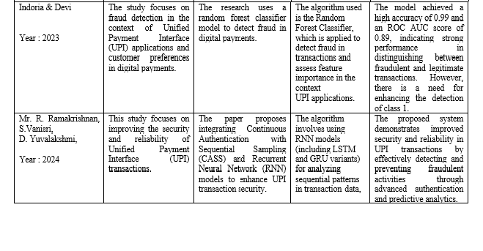
LITERATURE SURVEY TABLE

Slide 8
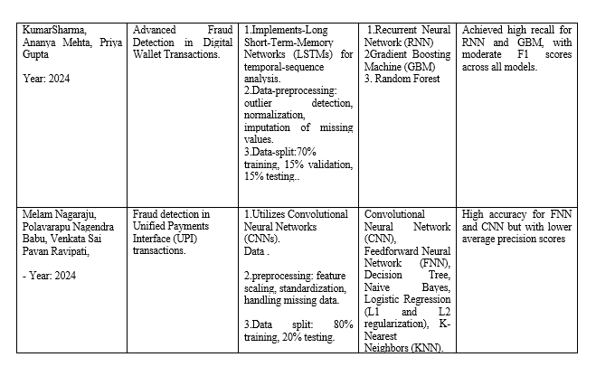
LITERATURE SURVEY TABLE

Slide 9
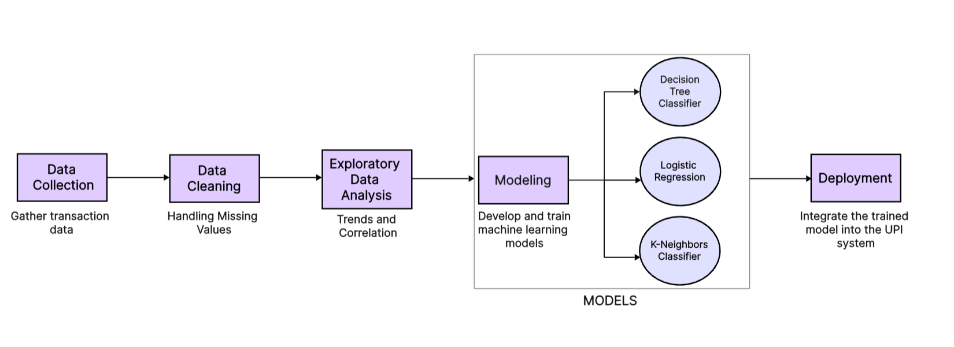
Methodology
Work Flow

Slide 10
Methodology
Data Set : Train the model on an online fraud dataset containing over 6.3 million rows and 11 attributes.
Key Attributes: Focus on important parameters such as:
Payment Type (Debit, Transfer, Cash Out, Cash In)
Amount : Initial Amount .
Old Balance : Checks the old balance in the account .
New Balance : Checks the new balance in the account .
Objective: Develop a model to predict the parameter "Is Fraud" which indicates whether a transaction is fraudulent (1) or not (0).

Slide 11
Conclusion
We will develop a robust model to classify transactions as fraudulent or legitimate by analyzing historical transaction data. This model will leverage patterns and anomalies identified in past transactions to enhance fraud detection accuracy.
By continuously monitoring and learning from previous transaction trends, the model aims to provide real-time, reliable classification of transactions, thus significantly improving the security and integrity of financial operations.
This proactive approach ensures timely identification of fraud and helps protect users from financial losses.

Slide 12
REFERENCES
1.NAGARAJU, C. Reddy, Velpula Chaitanya, “Net Banking Fraud Detection Using Neural Networks(CNN),” Research Square (Research Square), Mar. 2024, doi: https://doi.org/10.21203/rs.3.rs-4088962/v1.
2.M. Kishori, D. Kadam, R. Omanna, S. Sakshi, Neje, and N. Suresh, “Online Transactions Fraud Detection using Machine Learning,” International Journal of Advances in Engineering and Management (IJAEM), vol. 5, no. 6, pp. 545–548, 2023, doi: https://doi.org/10.35629/5252-0506545548.
‌
.
3.Polavarapu “UPI Fraud Detection Using Convolutional Neural Networks(CNN),” Research Square (Research Square), Mar. 2024, doi: https://doi.org/10.21203/rs.3.rs-4088962/v1.
4. MELAM NAGARAJU, C. Reddy, Polavarapu Nagendra Babu, V. Sai, and Velpula Chaitanya, “Online Fraud Detection Using Classifcation Model’s,” Research Square (Research Square), Mar. 2024, doi: https://doi.org/10.21203/rs.3.rs-4088962/v1.
5. Nagendra Babu, “ Credit Card fraud Detection,” Research Square (Research Square), Mar. 2024, doi: https://doi.org/10.21203/rs.3.rs-4088962/v1.

Slide 13
Thank you

